Slide 1
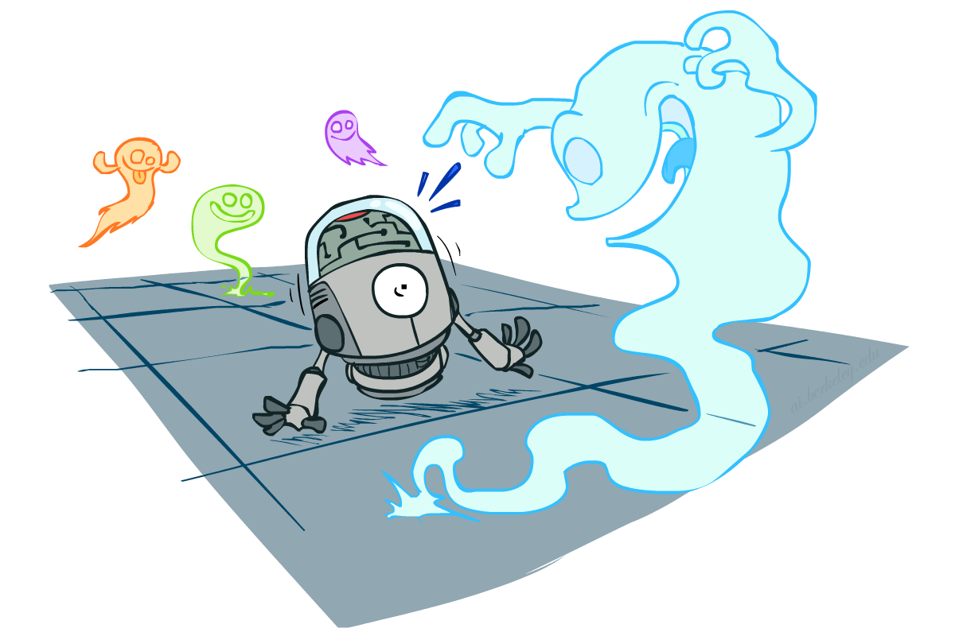
CS 188: Artificial Intelligence
Probability
Instructors: Dan Klein and Pieter Abbeel --- University of California, Berkeley
[These slides were created by Dan Klein and Pieter Abbeel for CS188 Intro to AI at UC Berkeley. All CS188 materials are available at http://ai.berkeley.edu.]
Notes:
Please retain proper attribution, including the reference to ai.berkeley.edu. Thanks!

Slide 2

Probability
Random Variables
Joint and Marginal Distributions
Conditional Distribution
Product Rule, Chain Rule, Bayes’ Rule
Inference
Independence
You’ll need all this stuff A LOT for the next few weeks, so make sure you go over it now!
Notes:
Like “sort this list” or “add these two numbers”

Slide 3
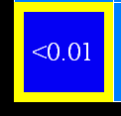
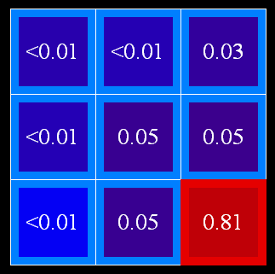

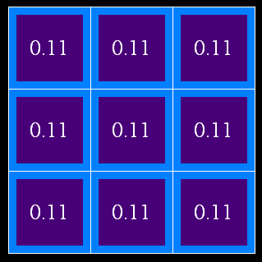
Uncertainty
General situation:
Observed variables (evidence): Agent knows certain things about the state of the world (e.g., sensor readings or symptoms)
Unobserved variables: Agent needs to reason about other aspects (e.g. where an object is or what disease is present)
Model: Agent knows something about how the known variables relate to the unknown variables
Probabilistic reasoning gives us a framework for managing our beliefs and knowledge

Slide 4
Random Variables
A random variable is some aspect of the world about which we (may) have uncertainty
R = Is it raining?
T = Is it hot or cold?
D = How long will it take to drive to work?
L = Where is the ghost?
We denote random variables with capital letters
Like variables in a CSP, random variables have domains
R in {true, false} (often write as {+r, -r})
T in {hot, cold}
D in [0, ∞)
L in possible locations, maybe {(0,0), (0,1), …}

Slide 5
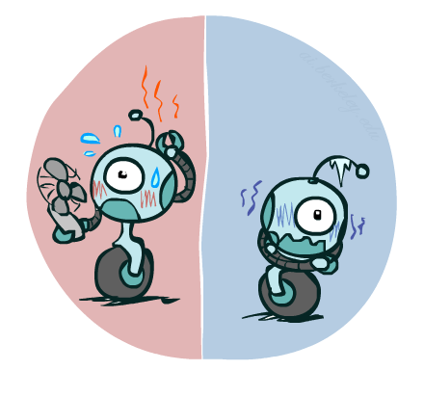

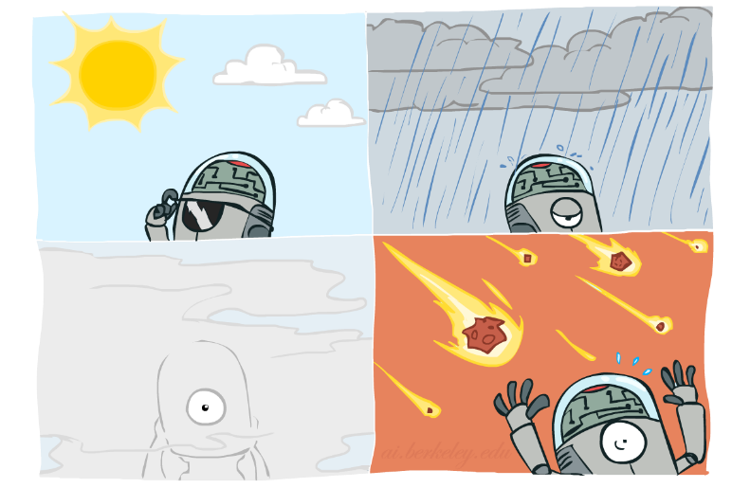

Probability Distributions
Associate a probability with each value
Temperature:
Weather:
W | P
sun | 0.6
rain | 0.1
fog | 0.3
meteor | 0.0
T | P
hot | 0.5
cold | 0.5

Slide 6


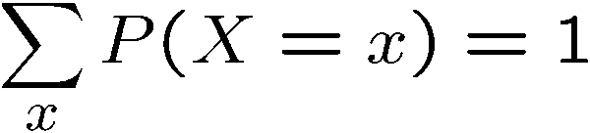
Probability Distributions
Unobserved random variables have distributions
A distribution is a TABLE of probabilities of values
A probability (lower case value) is a single number
Must have: and
Shorthand notation:
OK if all domain entries are unique
T | P
hot | 0.5
cold | 0.5
W | P
sun | 0.6
rain | 0.1
fog | 0.3
meteor | 0.0

Slide 7




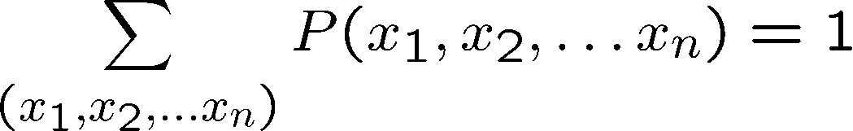
Joint Distributions
A joint distribution over a set of random variables:
specifies a real number for each assignment (or outcome):
Must obey:
Size of distribution if n variables with domain sizes d?
For all but the smallest distributions, impractical to write out!
T | W | P
hot | sun | 0.4
hot | rain | 0.1
cold | sun | 0.2
cold | rain | 0.3

Slide 8
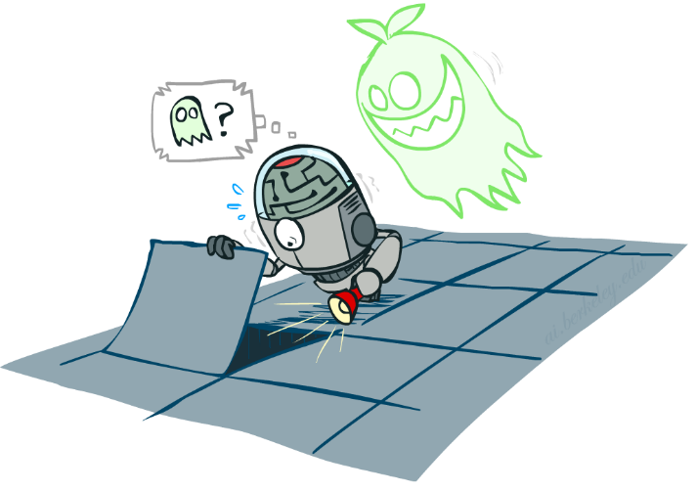

Probabilistic Models
Distribution over T,W
A probabilistic model is a joint distribution over a set of random variables
Probabilistic models:
(Random) variables with domains
Assignments are called outcomes
Joint distributions: say whether assignments (outcomes) are likely
Normalized: sum to 1.0
Ideally: only certain variables directly interact
Constraint satisfaction problems:
Variables with domains
Constraints: state whether assignments are possible
Ideally: only certain variables directly interact
T | W | P
hot | sun | 0.4
hot | rain | 0.1
cold | sun | 0.2
cold | rain | 0.3
Constraint over T,W
T | W | P
hot | sun | T
hot | rain | F
cold | sun | F
cold | rain | T

Slide 9
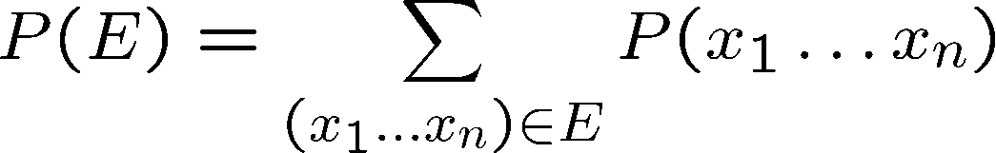
Events
An event is a set E of outcomes
From a joint distribution, we can calculate the probability of any event
Probability that it’s hot AND sunny?
Probability that it’s hot?
Probability that it’s hot OR sunny?
Typically, the events we care about are partial assignments, like P(T=hot)
T | W | P
hot | sun | 0.4
hot | rain | 0.1
cold | sun | 0.2
cold | rain | 0.3

Slide 10

Quiz: Events
P(+x, +y) ?
P(+x) ?
P(-y OR +x) ?
X | Y | P
+x | +y | 0.2
+x | -y | 0.3
-x | +y | 0.4
-x | -y | 0.1

Slide 11
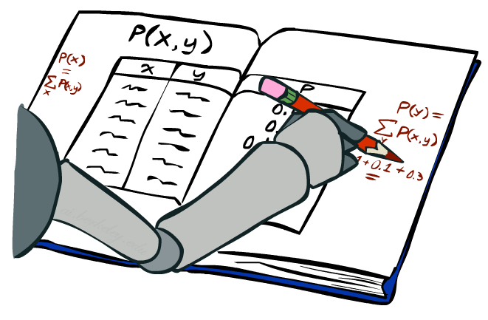
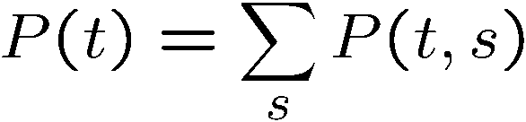
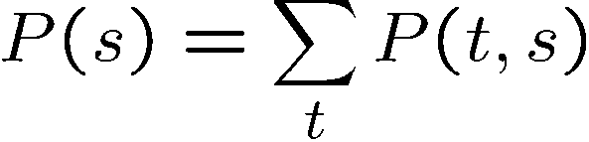
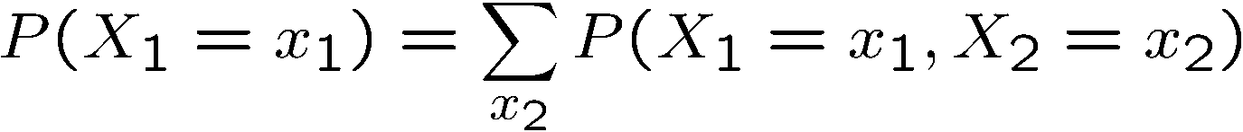
Marginal Distributions
Marginal distributions are sub-tables which eliminate variables
Marginalization (summing out): Combine collapsed rows by adding
T | P
hot | 0.5
cold | 0.5
T | W | P
hot | sun | 0.4
hot | rain | 0.1
cold | sun | 0.2
cold | rain | 0.3
W | P
sun | 0.6
rain | 0.4

Slide 12


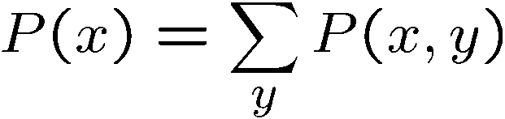

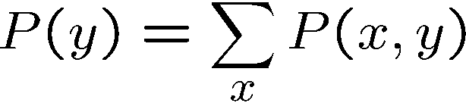
Quiz: Marginal Distributions
X | P
+x
-x
X | Y | P
+x | +y | 0.2
+x | -y | 0.3
-x | +y | 0.4
-x | -y | 0.1
Y | P
+y
-y

Slide 13
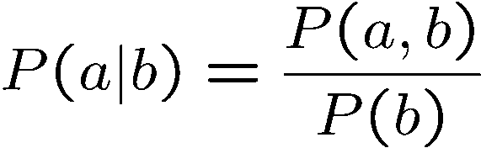
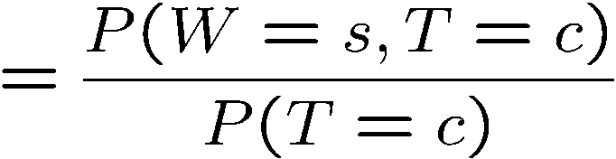
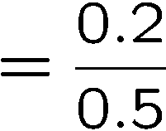



Conditional Probabilities
A simple relation between joint and conditional probabilities
In fact, this is taken as the definition of a conditional probability
P(a,b)
P(a)
P(b)
T | W | P
hot | sun | 0.4
hot | rain | 0.1
cold | sun | 0.2
cold | rain | 0.3

Slide 14
Quiz: Conditional Probabilities
P(+x | +y) ?
P(-x | +y) ?
P(-y | +x) ?
X | Y | P
+x | +y | 0.2
+x | -y | 0.3
-x | +y | 0.4
-x | -y | 0.1

Slide 15



Conditional Distributions
Conditional distributions are probability distributions over some variables given fixed values of others
Conditional Distributions
Joint Distribution
W | P
sun | 0.8
rain | 0.2
T | W | P
hot | sun | 0.4
hot | rain | 0.1
cold | sun | 0.2
cold | rain | 0.3
W | P
sun | 0.4
rain | 0.6

Slide 16
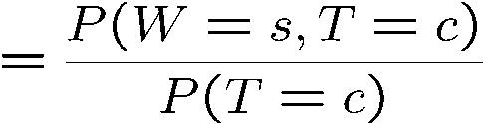

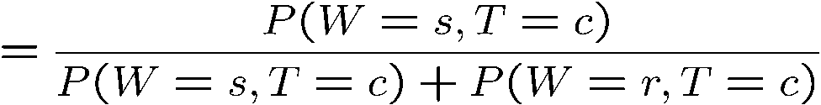
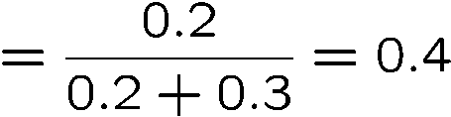

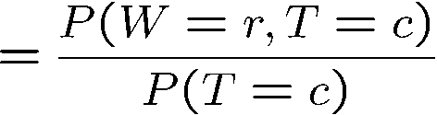

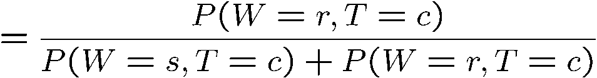
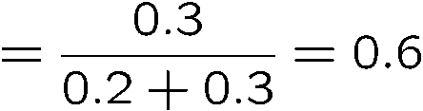
Normalization Trick
T | W | P
hot | sun | 0.4
hot | rain | 0.1
cold | sun | 0.2
cold | rain | 0.3
W | P
sun | 0.4
rain | 0.6

Slide 17








Normalization Trick
SELECT the joint probabilities matching the evidence
NORMALIZE the selection
(make it sum to one)
T | W | P
hot | sun | 0.4
hot | rain | 0.1
cold | sun | 0.2
cold | rain | 0.3
T | W | P
cold | sun | 0.2
cold | rain | 0.3
W | P
sun | 0.4
rain | 0.6

Slide 18

Quiz: Normalization Trick
P(X | Y=-y) ?
SELECT the joint probabilities matching the evidence
NORMALIZE the selection
(make it sum to one)
X | Y | P
+x | +y | 0.2
+x | -y | 0.3
-x | +y | 0.4
-x | -y | 0.1

Slide 19
Full Joint Probability Distribution
Gender(G) | Category(C) | Juice(J) | P(G,C,J)
M | S | O | 8/50
M | S | Mn | 6/50
M | S | L | 4/50
M | T | O | 3/50
M | T | Mn | 2/50
M | T | L | 2/50
F | S | O | 5/50
F | S | Mn | 7/50
F | S | L | 5/50
F | T | O | 2/50
F | T | Mn | 4/50
F | T | L | 2/50
Juice bar survey:
8 male students, 5 female students, 3 male teachers and 2 female teachers bought orange juice
6 male students, 7 female students, 2 male teachers and 4 female teachers bought mango juice
4 male students, 5 female students, 2 male teachers and 2 female teachers bought lemon juice

